Slide 1

Vue.js
The Progressive JavaScript Framework

Slide 2
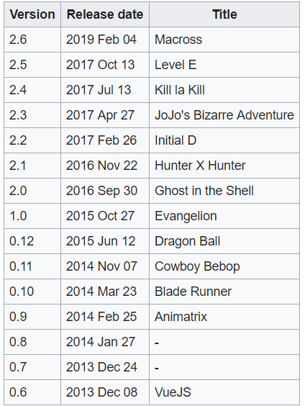

Slide 3
What is Vue.js
An open-source JavaScript framework for building user interfaces and single-page applications
Virtual DOM
Component-based UI development
Easy learning curve
Lightweight and fast
For Vue compare with other frameworks, see https://vuejs.org/v2/guide/comparison.html

Slide 4
Quick Start
> npm install -g @vue/cli
> vue ui
Select a preset -> Manual
Select Router, Linter/Formatter
Select Unit test, e2e test if needed
Compiles and hot-reloads for development
> npm run serve

Slide 5
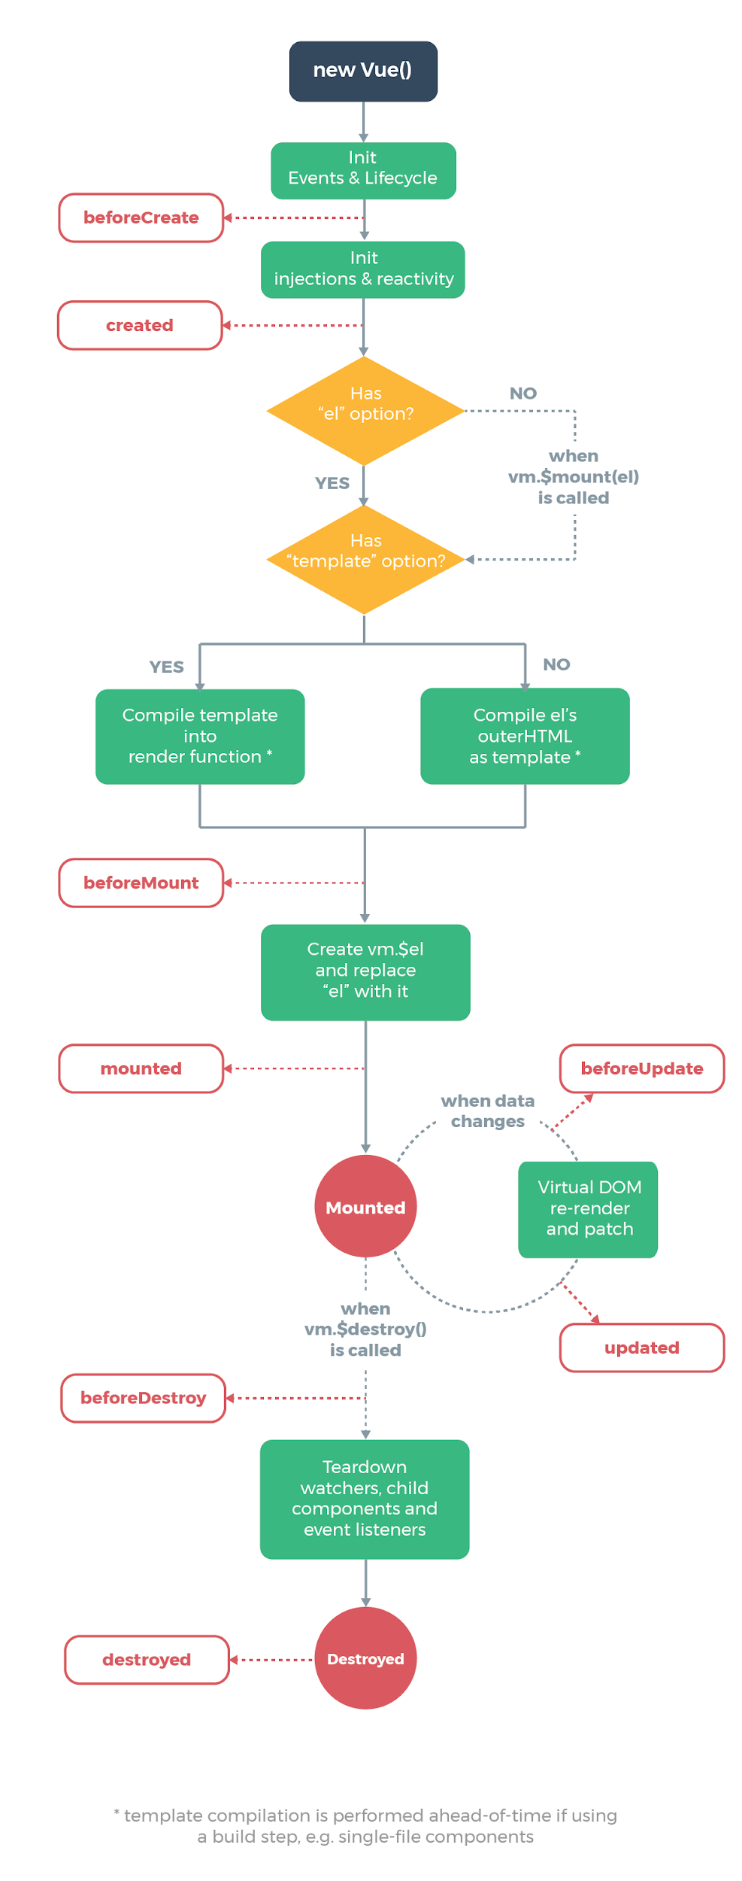
Livecycle Hooks
https://vuejs.org/v2/guide/instance.html#Lifecycle-Diagram
beforeCreate
created
beforeMount
mounted
beforeUpdate
updated
beforeDestroy
destroyed

Slide 6
Component
Template
Html-base syntax that define the DOM rendered
Script
Data, methods, lifecycle hooks in javascript
Style
css file that style elements

Slide 7
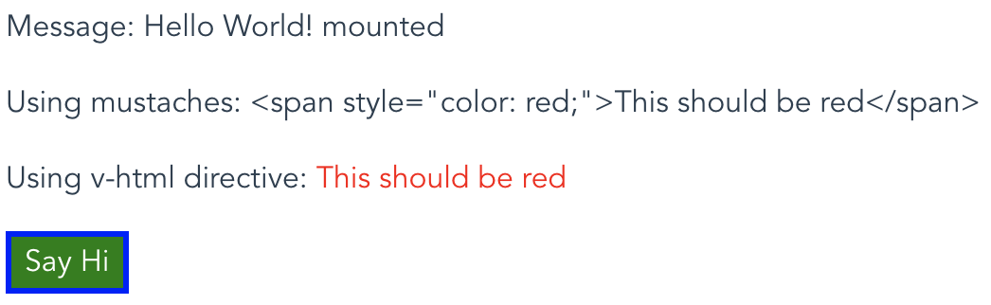
<template>
<div class="about text-left pl-5">
<div class="py-3">Message: {{ message }}</div>
<p>Using mustaches: {{ rawHtml }}</p>
<p>
Using v-html directive:
<span v-html="rawHtml"></span>
</p>
<button class="blue-border green-background-and-white-text" @click="say('Hi')">Say Hi</button>
</div>
</template>
<script>
export default {
data() {
return {
message: 'Hello World!',
rawHtml: '<span style="color: red;">This should be red</span>'
};
},
methods: {
say(message) {
alert(message);
}
},
mounted() {
this.message = this.message.concat(' mounted');
}
};
</script>
<style>
.blue-border {
border: 3px solid blue;
}
.green-background-and-white-text {
background: green;
color: white;
}
</style>

Slide 8
Template Syntax
Text
<span>Message: {{ msg }}</span>
Shorthands
v-bind shorthand
<!-- full syntax -->
<a v-bind:href="url"> ... </a>
<!-- shorthand -->
<a :href="url"> ... </a>
v-on shorthand
<!-- full syntax -->
<a v-on:click="doSomething"> ... </a>
<!-- shorthand -->
<a @click="doSomething"> ... </a>
Raw Html
<span v-html="rawHtml"></span></p>
Attributes
<div v-bind:id="dynamicId"></div>
<button v-bind:disabled="isButtonDisabled">Button</button>
Arguments
<a v-bind:href="url"> link </a>
Using javascript expression
{{ number + 1 }}
{{ ok ? 'YES' : 'NO' }}
{{ message.split('').reverse().join('') }}
<div v-bind:id="'list-' + id"></div>
Notes:
Evaluate variables

Slide 9
Computed Properties
<div id="example">{{ message.split('').reverse().join('') }}</div>
computed: {
// a computed getter
reversedMessage: function () {
// `this` points to the vm instance
return this.message.split('').reverse().join('')
}
}
<p>Computed reversed message: "{{ reversedMessage }}"</p>
Computed Caching vs Methods
methods: {
reverseMessage() {
// this will execute every time method get called
return this.message.split("").reverse().join("");
}
},
computed: {
now() {
return Date.now() // this computed property will never update
}
}

Slide 10
Computed vs Watched property
<div id="demo">{{ fullName }}</div>
data() {
return {
firstName: 'Foo',
lastName: 'Bar',
fullName: 'Foo Bar'
}
},
watch: {
firstName: function(val) {
this.fullName = val + ' ' + this.lastName;
},
lastName: function(val) {
this.fullName = this.firstName + ' ' + val;
}
}
data() {
return {
firstName: 'Foo',
lastName: 'Bar'
}
},
computed: {
fullName: function () {
return this.firstName + ' ' + this.lastName
}
}

Slide 11
Computed vs Watched property
Computed setter
computed: {
fullName: {
// getter
get: function () {
return this.firstName + ' ' + this.lastName
},
// setter
set: function (newValue) {
var names = newValue.split(' ')
this.firstName = names[0]
this.lastName = names[names.length - 1]
}
}
}
What about watcher?
This is most useful when you want to perform asynchronous or expensive operations in response to changing data.

Slide 12
Class and Style Binding
<div
class="static"
// Object syntax
v-bind:class="{ active: isActive, 'text-danger': hasError }"
v-bind:style="{ color: activeColor, fontSize: fontSize + 'px' }"
// Array syntax
v-bind:class="[isActive ? activeClass : '', errorClass]"
v-bind:style="[baseStyles, overridingStyles]"
</div>

Slide 13
Conditional Rendering
v-if
<div v-if="type === 'A'">A</div>
<div v-else-if="type === 'B'">B</div>
<div v-else-if="type === 'C'">C</div>
<div v-else>Not A/B/C</div>
v-show
<h1 v-show="ok">Hello!</h1>
v-if vs v-show
v-if is “real” conditional rendering because it ensures that event listeners and child components inside the conditional block are properly destroyed and re-created during toggles.
v-if is also lazy: if the condition is false on initial render, it will not do anything - the conditional block won’t be rendered until the condition becomes true for the first time.
In comparison, v-show is much simpler - the element is always rendered regardless of initial condition, with CSS-based toggling.
Generally speaking, v-if has higher toggle costs while v-show has higher initial render costs. So prefer v-show if you need to toggle something very often, and prefer v-if if the condition is unlikely to change at runtime.

Slide 14
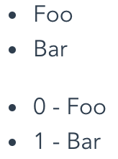
List Rendering
data: {
items: [
{ message: 'Foo' },
{ message: 'Bar' }
]
}
<ul id="example-1">
<li v-for="item in items">
{{ item.message }}
</li>
</ul>
<ul id="example-2">
<li v-for="(item, index) in items">
{{ index }} - {{ item.message }}
</li>
</ul>
// v-for also works with Objects

Slide 15
Event Handling
data: {
counter: 0
},
methods: {
greet() {
alert("Hello!")
},
say(message) {
alert(message)
}
}
<button v-on:click="counter += 1">Add 1</button>
<button v-on:click="greet">Greet</button>
<button v-on:click="say('hi')">Say hi</button>
<button v-on:click="say('what')">Say what</button>
Other events:
change,
click,
mouseover,
mouseout,
keydown
...

Slide 16
Form Input Bindings
Text Input
<input v-model="message" placeholder="edit me">
Text Area
<textarea v-model="message" placeholder="add multiple lines"></textarea>
Checkbox
<input type="checkbox" id="checkbox" v-model="checked">
Radio
<input type="radio" id="one" value="One" v-model="picked">
<label for="one">One</label>
<br>
<input type="radio" id="two" value="Two" v-model="picked">
Select
<label for="two">Two</label><select v-model="selected">
<option disabled value="">Please select one</option>
<option>A</option>
<option>B</option>
<option>C</option>
</select>

Slide 17
BootstrapVue
Bootstrap v4 is the world's most popular framework for building responsive, mobile-first sites.
> vue add bootstrap-vue

Slide 18
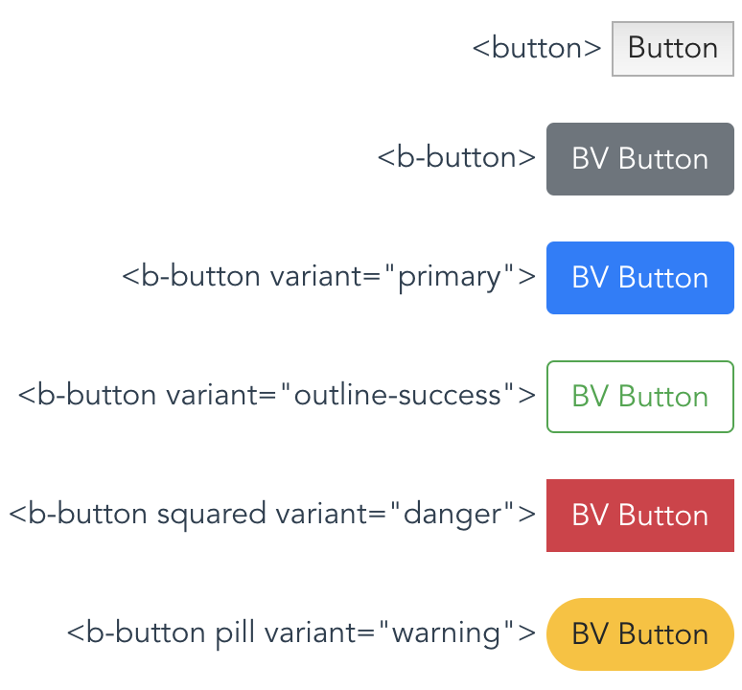
BootstrapVue
For other components, see https://bootstrap-vue.js.org/docs/components/alert

Slide 19
CSS
CSS is a language that describes the style of an HTML document.
CSS describes how HTML elements should be displayed.

Slide 20
CSS
tag
id
class
Other attributes
<button id="my-button" class="blue-border white-text" lang="en-us">abc</button>

Slide 21
CSS Selector
tag
body {}
button {}
p {}
hr {}
...
id
#my-button {}
#animal-table {}
...
class
.red-background {}
.pretty-button {}
.align-content-center {}
...
Notes:
How to select element

Slide 22
CSS Selector
.class1.class2 | Selects all elements with both class1 and class2 set within its class attribute
selector1, selector2 | Select all elements of selector1 and selector2
selector1 selector2 | Selects all elements with selector2 that is a descendant of an element with selector1
selector1 > selector2 | Selects all elements with selector2 that are direct children of an element with selector1
selector1 + selector2 | Selects all selector2 elements that are placed immediately after selector1 elements
selector1 ~ selector2 | Selects all selector2 elements that are placed after selector1 elements and have the same parent
Notes:
How to select element

Slide 23
CSS Selector
[attr] | Represents elements with an attribute name of attr. [type]
[attr=value] | Represents elements with an attribute name of attr whose value is exactly value. [type=password]
[attr~=value] | Represents elements with an attribute name of attr whose value is a whitespace-separated list of words, one of which is exactly value. div[lang~="en-us"] will select <div lang="en-us en-gb en-au en-nz">Hello World!</div>
[attr|=value] | Represents elements with an attribute name of attr whose value can be exactly value or can begin with value immediately followed by a hyphen, - (U+002D). It is often used for language subcode matches. div[lang|="zh"] will select both <div lang="zh-CN">世界您好！</div> <div lang="zh-TW">世界您好！</div>
[attr^=value] | Represents elements with an attribute name of attr whose value is prefixed (preceded) by value. a[href^="https"]
[attr$=value] | Represents elements with an attribute name of attr whose value is suffixed (followed) by value. a[href$=".org"]
[attr*=value] | Represents elements with an attribute name of attr whose value contains at least one occurrence of value within the string. a[href*="example"]
Notes:
How to select element

Slide 24
CSS Selector
element:enabled
element:disabled
element:focus
element:hover
element:link
element:visited
element:active
element:first-child
element:last-child
element:nth-child(n)
element::after
element::before
element::selection
And many more...
Notes:
How to select element

Slide 25
Styling Text
color
font-family
font-style(normal,italic)
font-weight(normal, bold, lighter, bolder, 100-900)
text-transform(none, uppercase, lowercase, capitalize,full-width)
text-decoration(none, underline, overline, line-through)
text-shadow
text-align(center, left, right, justify)
and more...

Slide 26
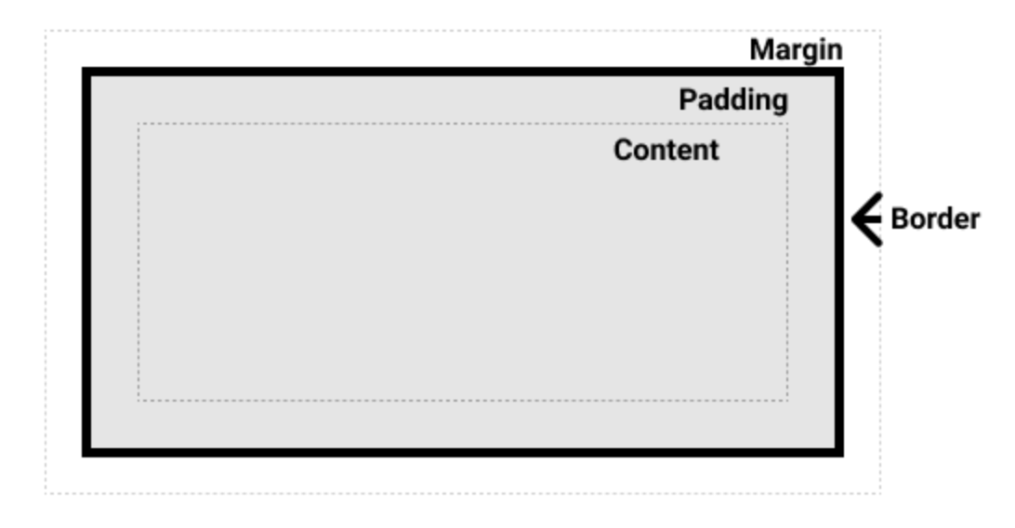
Styling Boxes
width
height
padding
margin
border
border-width
border-style
border-color
border-radius
box-shadow
background
background-color
background-image(url, linear-gradient, radio-gradient)
background-repeat(no-repeat, repeat-x, repeat-y, repeat)
background-position
overflow(scroll, visible, hidden)
object-fit(cover, contain, fill, none, scale-down)
and more...

Slide 27
Styling Layout
See https://bootstrap-vue.js.org/docs/components/layout for more detail

Slide 28
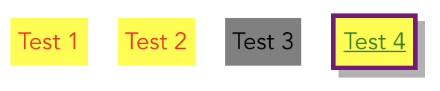
a {
color: red;
background-color: yellow;
margin: 10px;
padding: 5px;
}
a:hover {
color: green;
border: 3px solid purple;
box-shadow: 5px 5px rgba(0, 0, 0, 0.3);
}
a:visited {
color: black;
background-color: gray;
}

